Slide 1
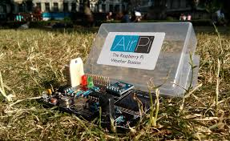
AUTOMATIC WEATHER STATION FOR IGDTUW
SUPERVISOR-
Dr. S.R.N.Reddy
By-
SRISHTI SINGH
(08213502812)
SUNAYNA PAL
(07613502812)
PRIYANKA SHARMA
(08013502812)

Slide 2
ACKNOWLEDGEMENT
This presentation-1 is being submitted as a part of internal assessment of the final year minor project of course B.Tech (major ECE) , Batch: 2012-2016, under the guidance of Dr. S.R.N. Reddy and evaluated by Dr. Richa Yadav.

Slide 3
OUTLINE
Problem Statement
Objective
Importance
Schematic Diagram
Module-1
Module-2
Module-3
Applications
Work done till now
Problems faced
Future Extension
References

Slide 4
PROBLEM STATEMENT
To develop an embedded system to design a weather monitoring system which enables the monitoring of weather parameters in an industry. Such a system contains pair of sensors like temperature, Gas and humidity will be monitored and Rasp-pi2 microcontroller. The data from the sensors are collected by the microcontroller and sends the sensors data through the SMS in the mobile with the help of Gateway.

Slide 5
OBJECTIVE
The main objective of this work is to develop a standalone modular weather station with a remote communication facility to capture and transmit meteorological parameters. Remotely monitoring of environmental parameters is important in various applications and industrial processes. In earlier period weather monitoring systems are generally based on mechanical, electromechanical instruments which suffer from the drawbacks like poor rigidity, need of human intervention, associated parallax errors and durability. This unmanned AWS and data logging would provide the ease of monitoring weather parameters of our university.

Slide 6
IMPORTANCE
This project can be combined with the control system that is needed in many applications ; such as agriculture applications (Green House and farmed animal breeding, renewable energy projects).
Warm effect needs climate monitoring .Studying of climate requires comparing of climate behaviours between different years and decades.
University Need; to get information about the weather that will be presented to community through our university.

Slide 7
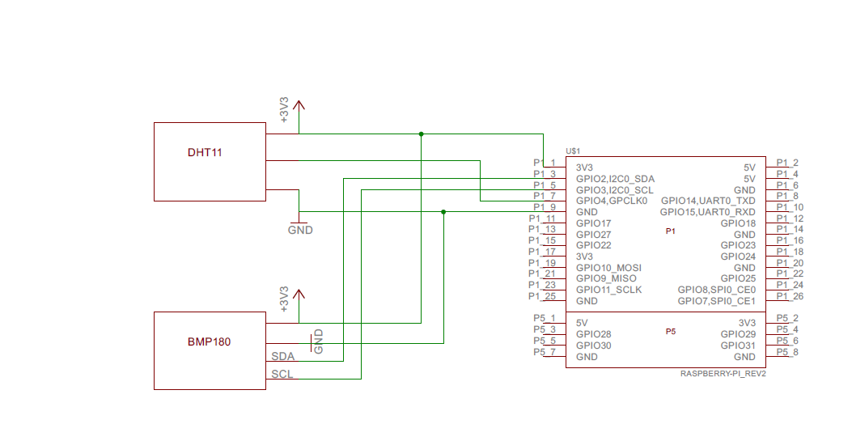
SCHEMATIC DIAGRAM-

Slide 8
MODULE-1
MICROCONTROLLER (Raspberry pi-2)
and related HARDWARE

Slide 9

Introduction to raspberry pi

Slide 10
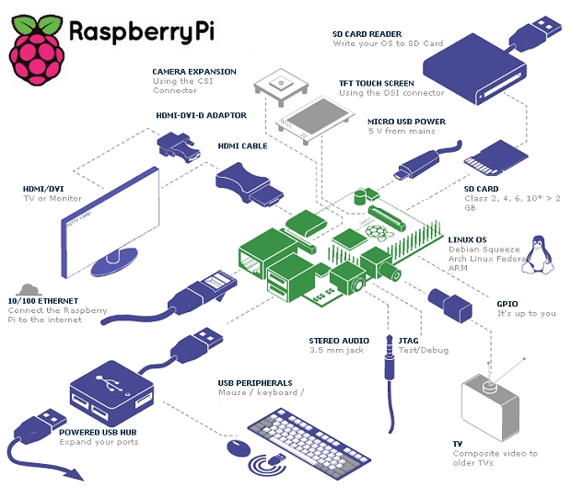
How to connect devices

Slide 11
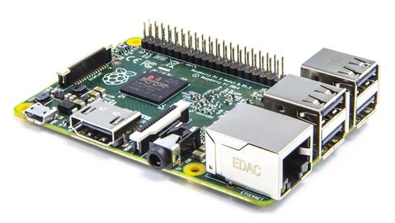
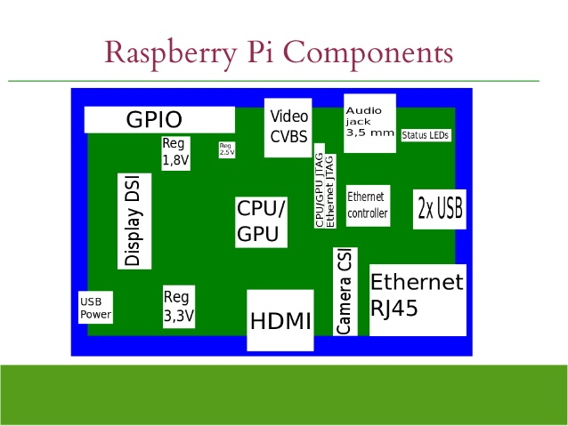

Slide 12
BENEFITS
Enhanced Quad Core Processor and 1GB RAM now provides you with the opportunity to:
Build your own workstation – create and manage your documents and spreadsheets with ease using LibreOffice
Faster and more enjoyable gaming – experience less lag and more seamless gaming in all your favourites. Can’t wait to demolish buildings in Minecraft, trigger your TNT now and be amazed by the results!
No more buffer face – boots up Raspbian in less than half the time as the Model B+
More power for your favourite projects – create Space Programmes, Time Lapse Videos, GPS tracking, HD audio and lots more with a full ecosystem of supporting accessories.
All your previous Raspberry Pi projects are 100% backward compatible with the new Raspberry Pi 2 Model B 1GB

Slide 13
Technical SPECIFICATIONS
Broadcom BCM2836 Arm7 Quad Core Processor powered Single Board Computer running at 900MHz
1 GB RAM
40 pin extended GPIO
4 x USB 2 ports
4 pole Stereo output and Composite video port
Full size HDMI
CSI camera port for connecting the Raspberry Pi camera
DSI display port for connecting the Raspberry Pi touch screen display
Micro SD port for loading your operating system and storing data
Micro USB power source

Slide 14
RASPBERRY PI2 FEATURES
Broadcom BCM2836 Arm7 Quad Core Processor powered Single Board Computer running at 900MHz.
1GB RAM so you can now run bigger and more powerful applications.
Identical board layout and footprint as the Model B+, so all cases and 3rd party add-on boards designed for the Model B+ will be fully compatible.
40pin extended GPIO to enhance your “real world” projects. GPIO is 100% compatible with the Model B+ and A+ boards. First 26 pins are identical to the Model A and Model B boards to provide full backward compatibility across all boards.
Connect a Raspberry Pi camera and touch screen display .
Stream and watch Hi-definition video output at 1080P
Micro SD slot for storing information and loading your operating systems.
Advanced power management:
You can now provide up to 1.2 AMP to the USB port – enabling you to connect more power hungry USB devices directly to the Raspberry PI. (This feature requires a 2Amp micro USB Power Supply).
10/100 Ethernet Port to quickly connect the Raspberry Pi to the Internet .
Combined 4-pole jack for connecting your stereo audio out and composite video out.

Slide 15
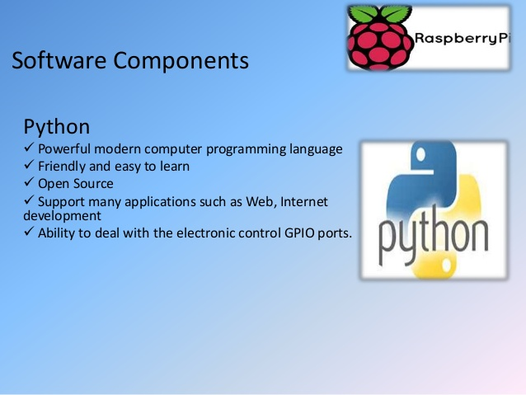
Language used
A variety of languages can be used with raspberry pi we are using python.

Slide 16
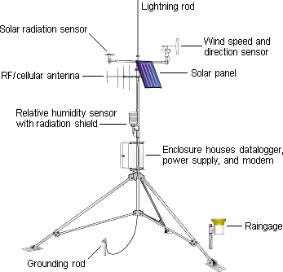
MODULE-2
SENSORS

Slide 17
What are Weather Sensors ?
Weather Sensors are instruments used to sense the analog pulses received by the surroundings regarding various environmental weather parameters , some of which are temperature, air pressure, wind direction and wind speed, humidity level, precipitation, pollution level, etc.

Slide 18
Types of Weather sensors
Sensors can be of 2 types depending upon the presence of an ADC (Analog to Digital Convertor) built-in it –
1. Analog Weather Sensors- They sense analog pulses and outputs them to the microcontroller directly.
2. Digital Weather Sensor-Device which sense analog input and perform A-D conversion internally to transmit the digital output to the processor.

Slide 19
Typical weather stations have the following sensors:
Thermometer for measuring air and sea surface temperature
Barometer for measuring atmospheric pressure
Hygrometer for measuring humidity.
Anemometer for measuring wind speed
Rain gauge for measuring liquid precipitation over a set period of time.
Pollution sensor for measuring pollution level in air.

Slide 20
SENSORS USED in our system :-
Temperature Sensor –DHT 11
Humidity Sensor-DHT11
Pressure Sensor-BMP-180

Slide 21
Temperature Sensor
A temperature sensor is a device, typically, a thermocouple or RTD, that provides for temperature measurement through an electrical signal. A thermocouple (T/C) is made from two dissimilar metals that generate electrical voltage in direct proportion to changes in temperature.
To accurately measure temperature the temperature sensor should be shielded from direct sunlight or precipitation and it should be adequately ventilated.
The factors that affect temperature sensors include latitude, the movement of air masses, solar radiation, and nearby bodies of water or land. Typically solar radiation and latitude are the biggest influences on the temperature reading.

Slide 22
HUMIDITY SENSOR
Humidity sensor works on the principle of relative humidity and gives the output in the form of voltage. This analog voltage provides the information about the percentage relative humidity present in the environment. A miniature sensor consisting of a RH sensitive material deposited on a ceramic substrate. The AC resistance (impedance) of the sensor decreases as relative humidity increases.

Slide 23
DHT-11-Temperature & Humidity Sensor for our AWS
The DHT11 is a basic, ultra low-cost digital temperature and humidity sensor. It uses a capacitive humidity sensor and a thermistor to measure the surrounding air, and spits out a digital signal on the data pin (no analog input pins needed). Its fairly simple to use, but requires careful timing to grab data.

Slide 24
TECHNICAL DETAILS:
Low cost
3 to 5V power and I/O
2.5mA max current use during conversion (while requesting data)
Good for 20-80% humidity readings with 5% accuracy
Good for 0-50°C temperature readings ±2°C accuracy
No more than 1 Hz sampling rate (once every second)
Body size 15.5mm x 12mm x 5.5mm
4 pins with 0.1" spacing.

Slide 25
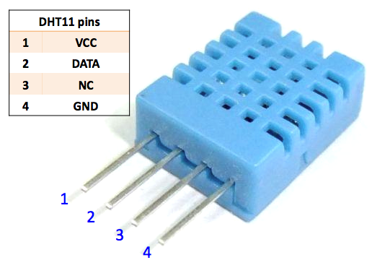
PIN-CONFIGURATION

Slide 26
BAROMETRIC SENSOR
A barometer is a scientific instrument used in meteorology to measure atmospheric pressure. Pressure tendency can forecast short term changes in the weather. Numerous measurements of air pressure are used within surface weather analysis to help find surfacetroughs, high pressure systems and frontal boundaries.
Most Personal Weather Stations include an electronic barometer, usually built into the Display Console.
Station Pressure is simply the true atmospheric pressure at a given location. It varies based on weather patterns, but also elevation. Higher elevation locations will always have lower Station Pressure than lower elevation sites.

Slide 27
BMP-180 (Barometric Pressure Sensor)
It is the next generation digital barometric sensor from Bosch and replaces BMP 085.
TECHNICAL SPECIFICATIONS :
Vin: 3 to 5VDC
Logic: 3 to 5V compliant
Pressure sensing range: 300-1100 hPa (9000m to -500m above sea level)
Up to 0.03hPa / 0.25m resolution
-40 to +85°C operational range, +-2°C temperature accuracy
This board/chip uses I2C 7-bit address 0x77.

Slide 28
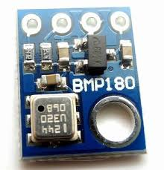
Typical applications :
Enhancement of GPS navigation (dead-reckoning, slope detection, etc.) In- and out-door navigation Leisure and sports Weather forecast Vertical velocity indication (rise/sink speed).

Slide 29
MODULE-3
COMMUNICATION MODULE

Slide 30
Communication hardware used in existing system
For communication three types of hardware are used:
GSM(Global mobile System) 3G Module
WIFI
Bluetooth

Slide 31
COMMUNICATIONS HARDWARE USED IN OUR PROPOSED WEATHER STATION
GATEWAY:
A gateway is a network point that acts as an entrance to another network. On the Internet, a node or stopping point can be either a gateway node or a host (end-point) node. Both the computers of Internet users and the computers that serve pages to users are host nodes. The computers that control traffic within your company's network or at your local Internet service provider (ISP) are gateway nodes.

Slide 32
SMS Gateway
SMS gateway allows a computer to send or receive Short Message Service (SMS) transmissions to or from a telecommunications network. Most messages are eventually routed into the mobile phone networks. Many SMS gateways support media conversion from email and other formats.

Slide 33
How SMS Gtaeway is used:
If you want to use mobile messaging in your company, the best practice is to setup an SMS gateway on one of your servers to handle all your mobile messaging needs. This SMS gateway can be connected to the mobile network through a wireless link, by using a GSM modem or through the Internet. It will provide a central point of access for your office users and your IT system when they want to use mobile messaging. This way you can avoid the chaos independent SMS service subscriptions can cause over time.

Slide 34
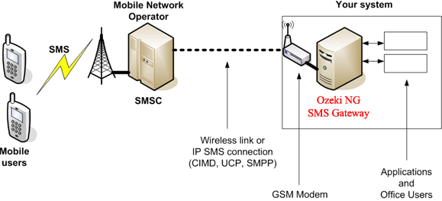

Slide 35
Internet based connection to the mobile network
If you wish to connect your SMS gateway to the mobile network through the Internet (in other words you want to use an IP SMS service), you should find an IP SMS service provider. This service provider will give you connection details after you sign up for it's service. When you select a provider make sure to find one, who is able to provide SMS over SMPP. SMPP is the best protocol for SMS messaging over the Internet, because it is asynchronous, fast and reliable. After you have signed up for the service, you need toconfigure the SMPP service provider connection in Ozeki NG SMS Gateway. The advantage of an IP SMS connection, is that it offers much higher throughput. The disadvantage is that it is often more expensive to send SMS messages this way, then by using a wireless link.

Slide 36
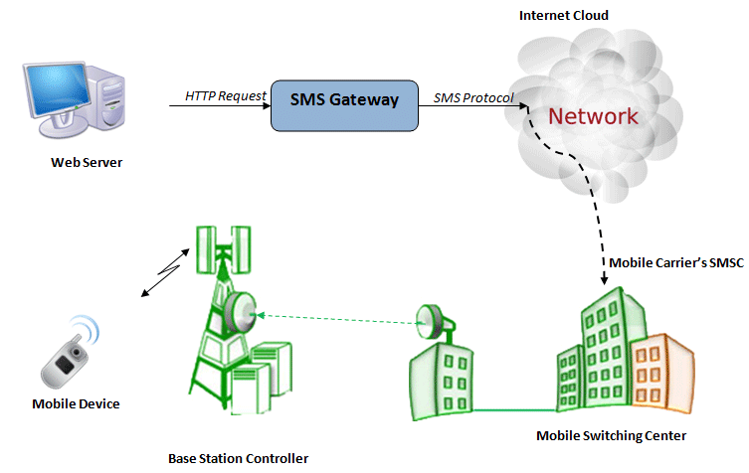

Slide 37
WIFI
A wireless network uses radio waves, just like cell phones, televisions and radios do. In fact, communication across a wireless network is a lot like two-way radio communication. Here's what happens:
A computer's wireless adapter translates data into a radio signal and transmits it using an antenna.

Slide 38
A wireless router receives the signal and decodes it. The router sends the information to the Internet using a physical, wired Ethernet connection.
They transmit at frequencies of 2.4 GHz or 5 GHz. This frequency is considerably higher than the frequencies used for cell phones, walkie-talkies and televisions. The higher frequency allows the signal to carry more data.
It uses 802.11 standard network.

Slide 39
Putty
Putty- This software will acting as a bridge between window pc and linux operating system on pi.
PuTTY is a free and open-source terminal emulator, serial console and network file transfer application. It supports several network protocols, including SCP, SSH, Telnet, rlogin, and raw socket connection. It can also connect to a serial port(since version 0.59). PuTTY was originally written for Microsoft Windows, but it has been ported to various other operating systems. Official ports are available for some Unix-like platforms, with work-in-progress ports to Classic Mac OS and Mac OS X, and unofficial ports have been contributed to platforms such as Symbian, Windows Mobile and Windows Phone

Slide 40
Applications
Used in coal mine, bio gas manufacturing centers.
Used in power plant generation.
Agriculture field monitoring.
Home automation.
Industrial purpose .

Slide 41
WORK DONE
Extensive study on the technology used in the system .
Collected the required hardware from embedded lab in college and through e-commerce websites.
Assembled the hardware according to the schematic diagram provided before.
Installed compatible os and support packages in the sd card for raspberry pi microcontroller
Installed required software (putty) in the laptop for connecting our hardware with the software .
Interfaced the sensors with the microcontroller and installed supporting libraries for the same from www.adafruit.com
Purchased SMS gateway free web service from www.textlocal.in ,to send a message on a mobile phone of the parameters measured.
Interfaced SMS gateway service with the microcontroller .
Tested the embedded system in working environment.

Slide 42
PROBLEMS FACED -
Unavailability of internet in the campus.
Unable to configure raspberry pi to the electronics department internet network.
The unavailability of many sensors such as harmful gases sensors(Co2… etc), pollution sensor.
The coding language of microcontroller is new to the team.
The available instruments and circuit components are expensive in comparison with international prizes.

Slide 43
Future Extension
Transfer of data over GSM/GPRS networks using respective modules for greater coverage and range is being looked at.
Adding of more sensors to monitor other environmental parameters such as Pollution Sensor, CO2 and oxygen Sensor, Raingage , wind speed sensor.
Also Integration of additional monitoring devices such as a Wi-Fi pi camera to monitor and analyze weather parameters visually.
Building up a user interface showing graphical representation for furthur analysis and interpretations.

Slide 44
References
http://www.antarctica.gov.au/about-antarctica/factfiles/weather/automatic-weather-stations.
Sensirion, Datasheet SHT7X Humidity and Temperature Sensor, Version 4.3, (2010) May.
Campbell Scientific, Data loggers, Sensors and Weather stations,
http://www.campbellsci.co.uk.
www.electronicsforu.com
www.wikipedia.com
www.github.com
www.adafruit.com
www.textlocal.in

Slide 45
THANK YOU

